Slide 1

Launch a New French Restaurant

Slide 2
Restaurant in one of the famous Cities of the world
New York, is one of the most linguistically diverse city in the world
French Cuisine is a heavenly amalgamation of culture, tradition, sophistication and, perhaps above all, a love for food. The French look beyond the ingredients and techniques that go into creating a rich blend of flavors. And is one of the popular cuisines in the world
The two thing put together could create a magic for the people and an immense profitable venture for a businessman.

Slide 3
Data Acquisition
Data
Data source : https://cocl.us/new_york_dataset - contains list Boroughs, Neighborhoods along with their latitude and longitude. This data set contains the required information. And we will use this data set to explore various neighborhoods of new york city.
Data source : Fousquare API – By using this api we will get all the venues in each neighborhood. We can filter these venues to get only French Resturants.
Data source : https://data.cityofnewyork.us/City-Government/Borough-Boundaries/tqmj-j8zm - By using this geo space data we will get the New york Borough boundaries that will help us visualize choropleth map.

Slide 4
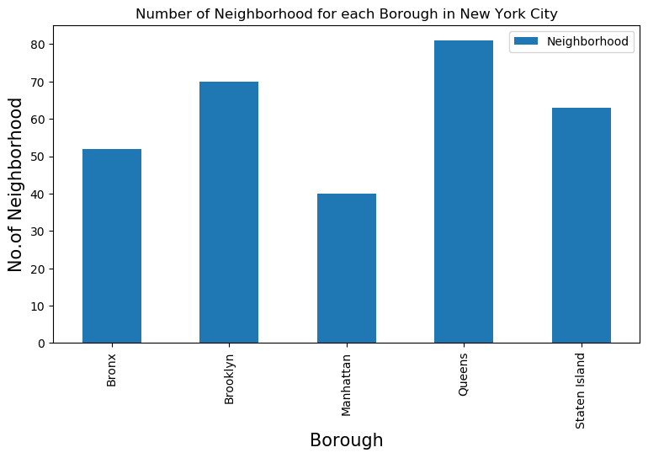
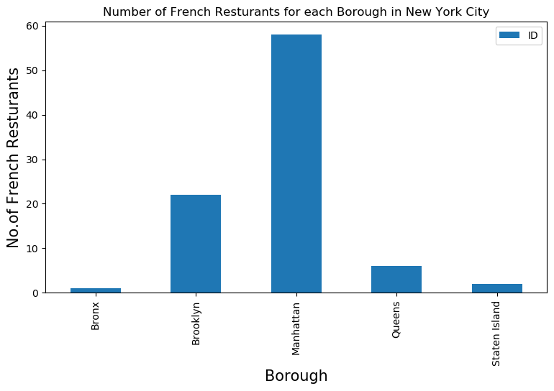
Exploring Ideal Location
There are two ideal location Staten Island and Bronx, but we will go with Bronx as the population is quite large and along with it , the profitablility

Slide 5

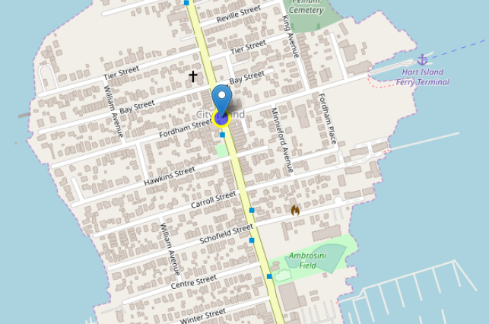
Map for possible locations
A Single French restaurant in an entire borough with a Rating of 7.5 , 13 likes and 7 tips. It looks as if there is not much justice done to the French Cuisine. We could see an opportunity to bring a class to this neighborhood which might turn out to be a profitable venture.

Slide 6
Conclusion
Bronx is the 3rd most densely population borough in New York. It has 52 neighborhoods, of which only 1 has a French restaurant. We have 51 places to explore and set up a restaurant
The quality of the new restaurant might even decide the future for a franchisee

